Slide 1


TF Lite Image Classification on edge device
Tim Crnkovic

Slide 2
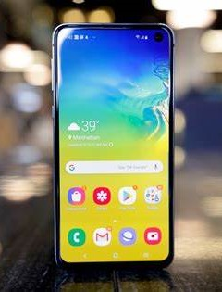
Can an TF Lite model be deployed to an Android phone…

Slide 3
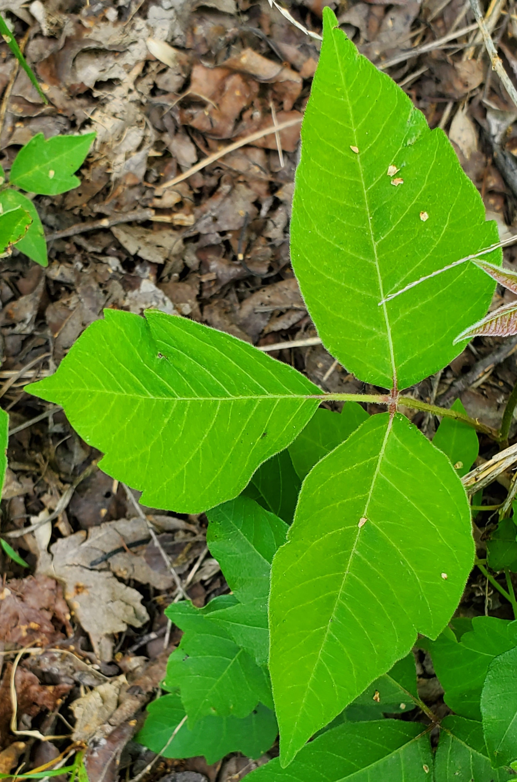
To distinguish irritant plants…

Slide 4
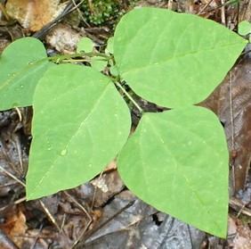
…from safe plants?

Slide 5
3 irritant categories. 7 safe categories.
Poison Ivy
Poison Oak
Poison Sumac
Hog Peanut
Boxelder
Virginia Creeper
Fragrant Sumac
Wild Strawberry
Wild Raspberry
Others

